Slide 1


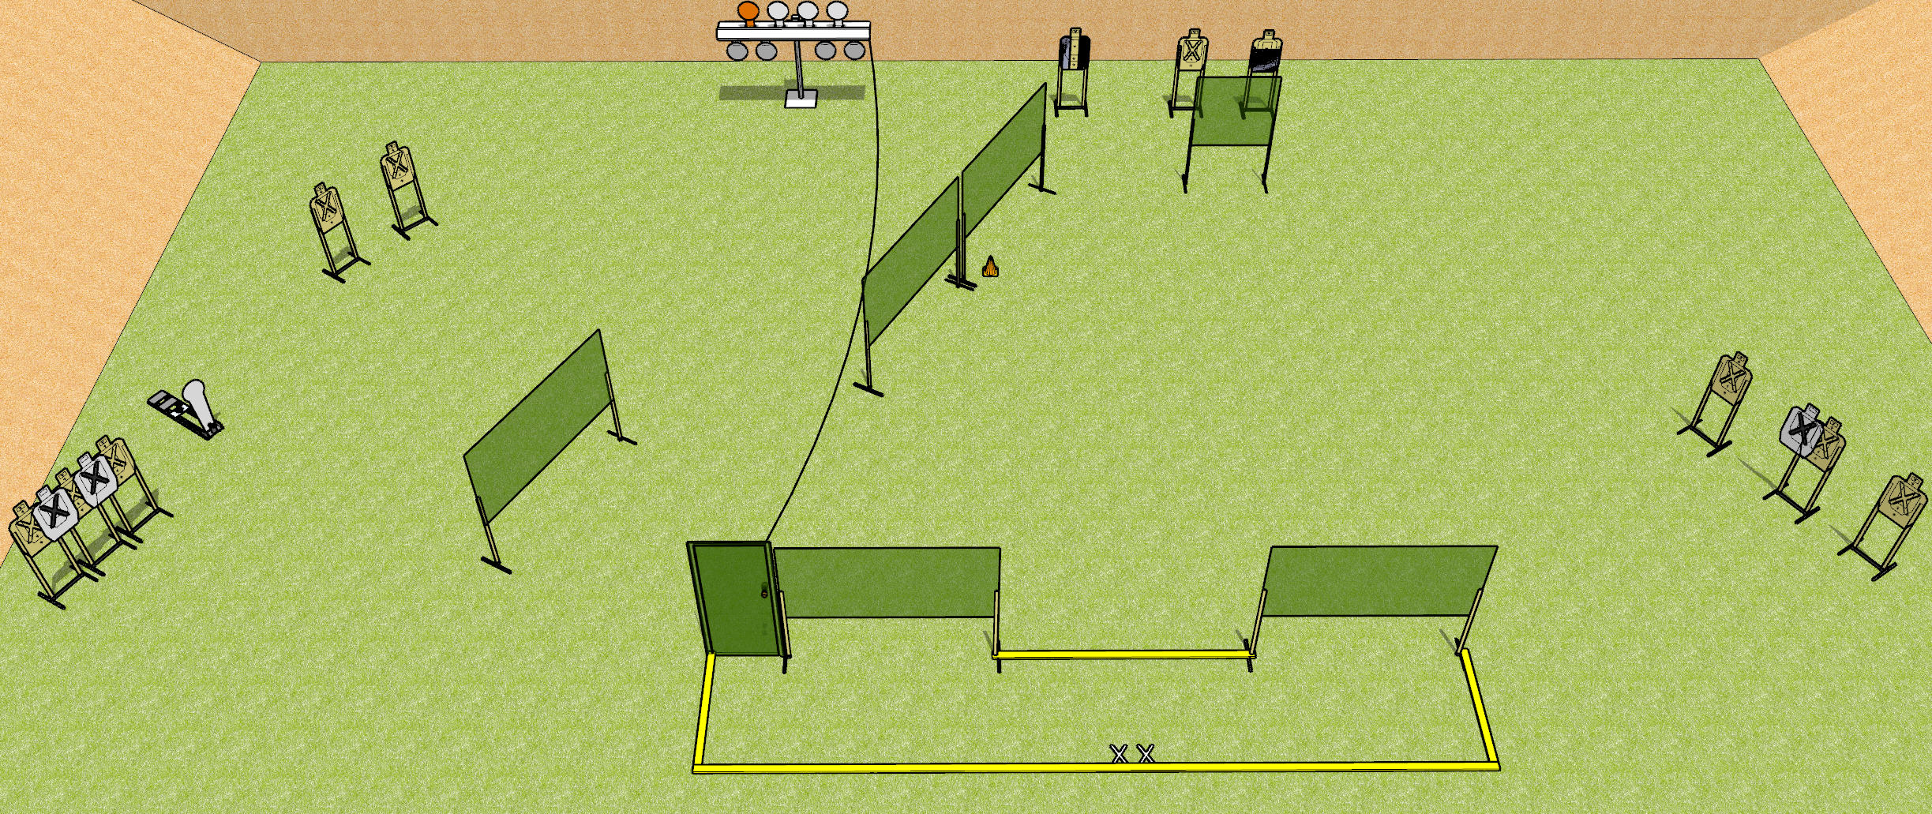
 | Dothan Gun Club – USPSA Match Sick and Twisted Course Designer : Drew Coleman
START POSITION : Standing with both feet on X’s. Hands relaxed at sides.
GUN READY CONDITION : Pistol loaded and holstered. PCC shouldered, safety on, pointed at orange cone. |  | SCORING: Comstock, 30 rounds TARGETS: 11 paper, 8 Steel SCORED HITS: Best 2 on paper, steel until down START-STOP: Audible, last shot RULES: Polish plate rack must be activated before being engaged.
STAGE PROCEDURE: Engage targets as they become available from within the fault lines

